Slide 1

ICICI BANK MANAGEMENT SYSTEM
Abhishek Mishra
© All rights reserved by Fireblaze Technologies Pvt. Ltd.

Slide 2
Problem Statement
ICICI Bank is currently facing challenges with their existing Bank Management System in relation to account type management, department management, bank details management, job details management, employee management, and customer management. The bank aim to address these issues by developing an enhanced system that resolves.
© All rights reserved by Fireblaze Technologies Pvt. Ltd.

Slide 3
Problem Statement
Every day and thousands of users used banking system in day to day life. As we know that if number of users increases us need more banks and more staff it means increasing manual work also we put more amount of money in bank it is more risky and not much secure.
© All rights reserved by Fireblaze Technologies Pvt. Ltd.

Slide 4
About the Data
The Database consists of 6 tables; Bank Details, Employees, Customer, Department, job_Details and Account_Type. The ‘Employees’ table consists of the base information about the employees.’Bank Details’, consists of the information about bank info. The table ‘Account_Type’ consists of the information regarding the account.
All there tables are connected using contraints such as department_id of job_details table is connected with department_id of department_id of department table using foreign key ect. Where as there are few attributes having primary key such as department_id, account_no having primary key.
© All rights reserved by Fireblaze Technologies Pvt. Ltd.

Slide 5
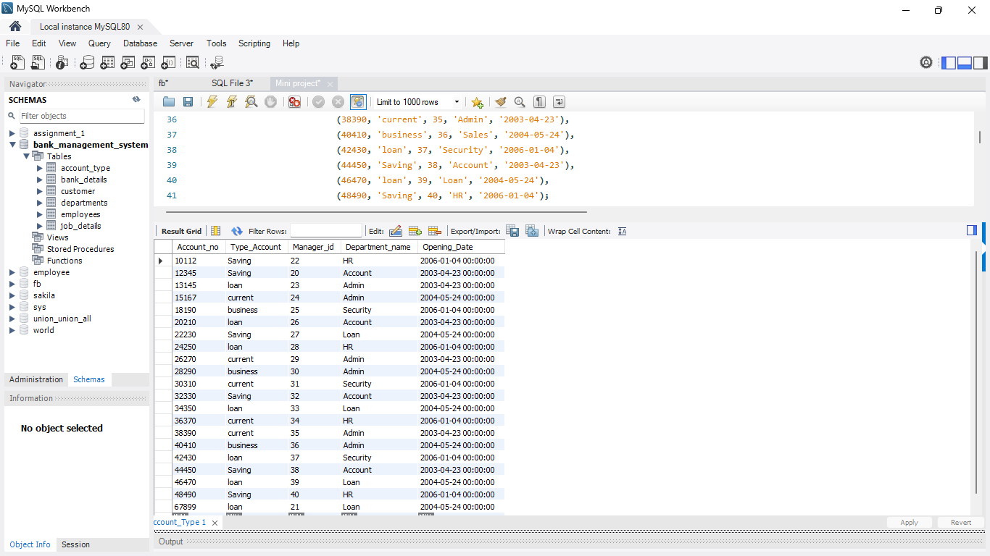
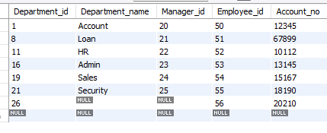
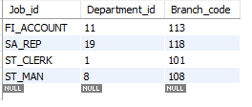
About the Data
© All rights reserved by Fireblaze Technologies Pvt. Ltd.

Slide 6
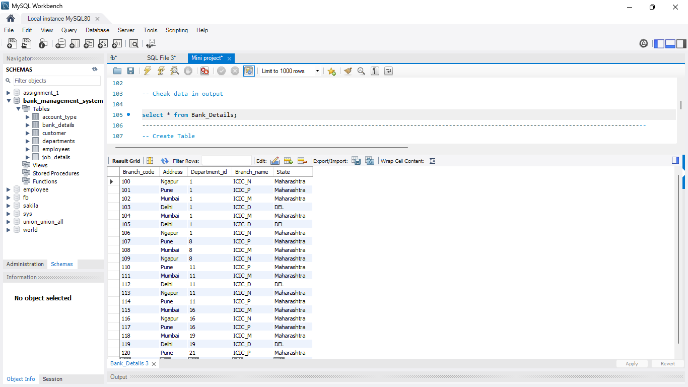
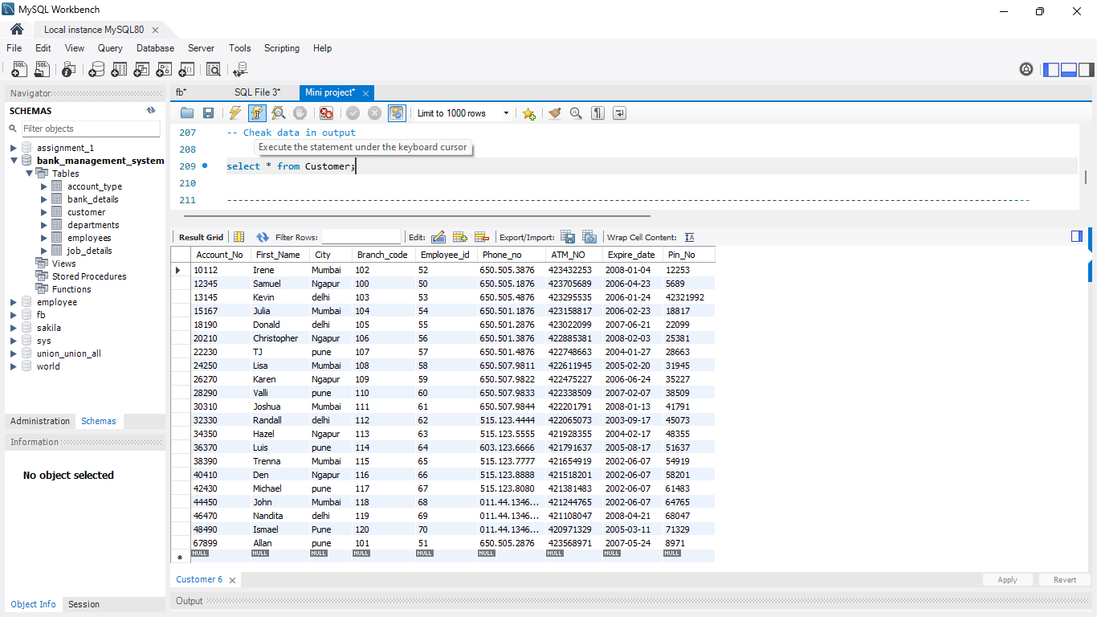
About the Data
© All rights reserved by Fireblaze Technologies Pvt. Ltd.

Slide 7
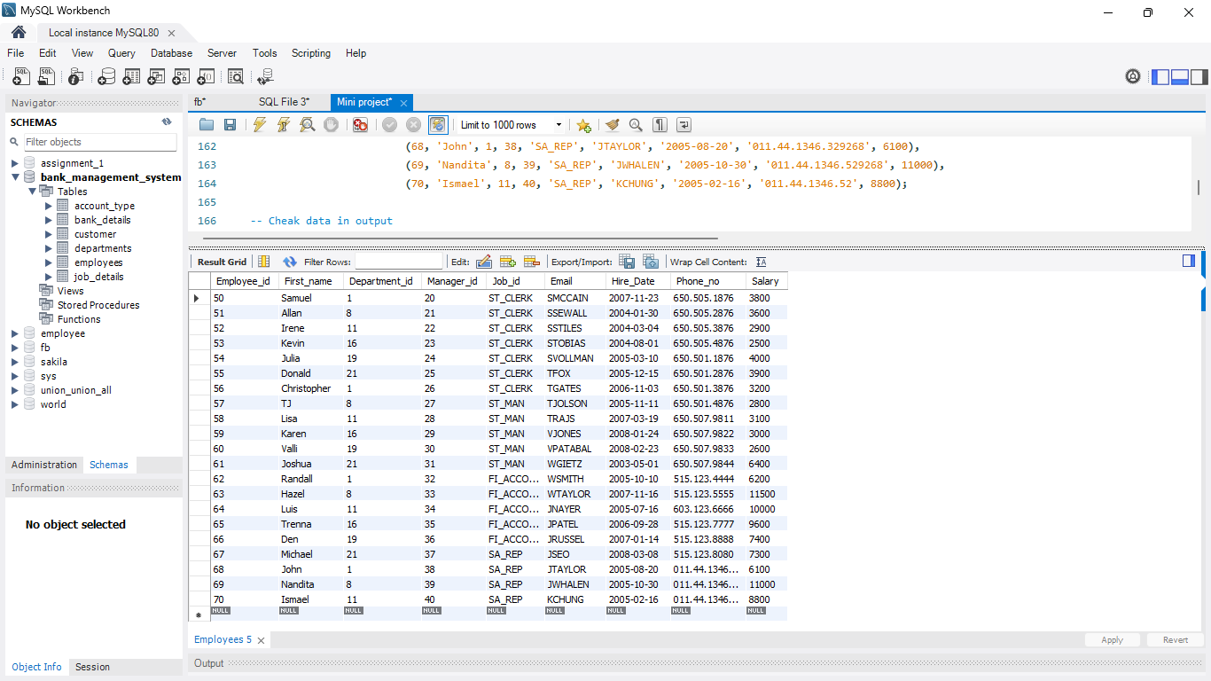
About the Data
© All rights reserved by Fireblaze Technologies Pvt. Ltd.

Slide 8
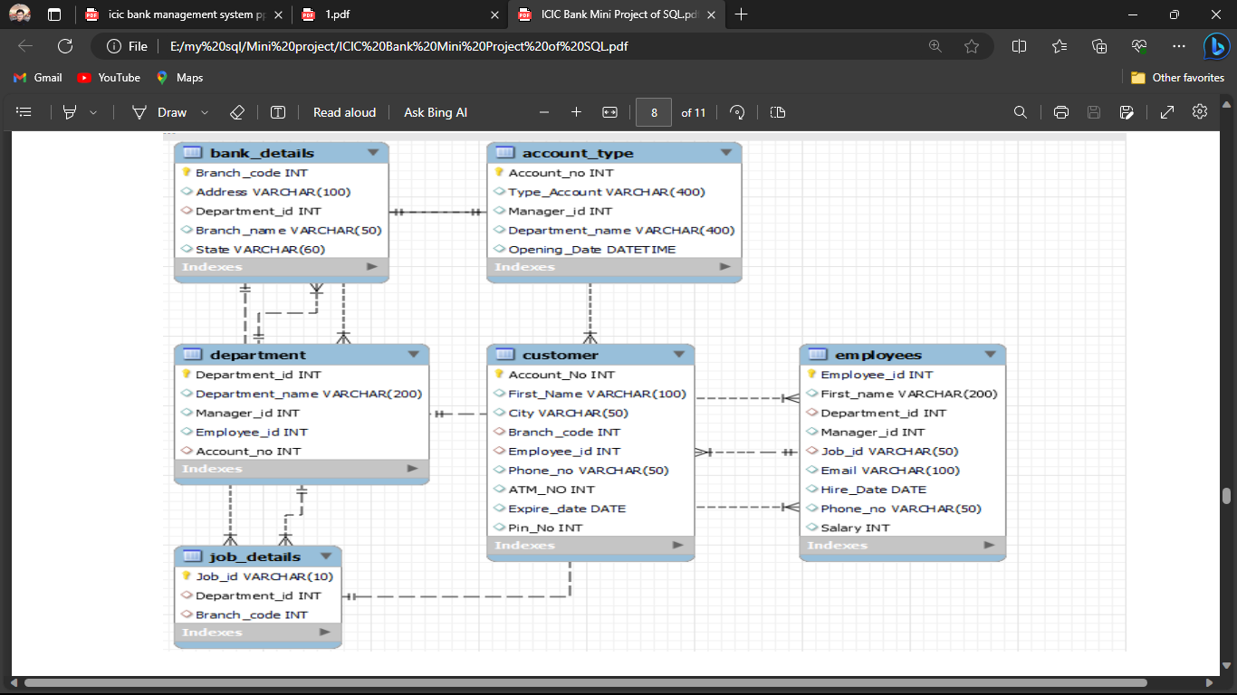
ER (Entity Relationship) Model
© All rights reserved by Fireblaze Technologies Pvt. Ltd.

Slide 9
Proposed Solution
To update, add, delete a row of data and retrieve subsets of information within the database. By using this database we will retrieve the information of particular person working in the organization.
The proposed system is highly computerized in which the data related to user accounts will be secured high with high accuracy that even reduced the machine damage and human made errors and this existing system is highly efficient to offer best services to the customers as well as bank because it has user friendly access that customers less time when compare with a normal banking system. When the data is entered it will check for its validity.
© All rights reserved by Fireblaze Technologies Pvt. Ltd.

Slide 10
Conclusion
I have successfully designed, develop and implemented this bank customers management system which provides a more secured approach in manage bank customer’s information and the relationships between banks and their customers by providing the right solutions that user a multilevel security to improve customer satification.
© All rights reserved by Fireblaze Technologies Pvt. Ltd.

Slide 11
Future Scope
In future we are thinking of adding more specifications and features to make it look better and easy to use. We are thinking of making a formula that will generate cash flow statement, daily transactions a all will be generated after one full year to show the progress of the business.
Artificial Intelligence (AI) and Machine Learning (ML), SQL can be in conjunction with AI and ML algorithms to develop intelligent banking applications. These applications can automate customer support, provide personalized recommendations, and enhance fraud detection capabilities.
Banking system is a way to maintain few records which bank holds in order to keep a track of everything in the bank so a software application is required in order to make the work easier.
© All rights reserved by Fireblaze Technologies Pvt. Ltd.

Slide 12

.
© All rights reserved by Fireblaze Technologies Pvt. Ltd.

